Slide 1

Exception
By : Neha P. Rajas
Asst. Prof. VIT
Notes:
This template can be used as a starter file to give updates for project milestones.
Sections
Right-click on a slide to add sections. Sections can help to organize your slides or facilitate collaboration between multiple authors.
Notes
Use the Notes section for delivery notes or to provide additional details for the audience. View these notes in Presentation View during your presentation.
Keep in mind the font size (important for accessibility, visibility, videotaping, and online production)
Coordinated colors
Pay particular attention to the graphs, charts, and text boxes.
Consider that attendees will print in black and white or grayscale. Run a test print to make sure your colors work when printed in pure black and white and grayscale.
Graphics, tables, and graphs
Keep it simple: If possible, use consistent, non-distracting styles and colors.
Label all graphs and tables.

Slide 2
Overview
Error
Exception
Exception Handling
Java Exception Classes
Java has 5 keywords for exception handling
Notes:
What is the project about?
Define the goal of this project
Is it similar to projects in the past or is it a new effort?
Define the scope of this project
Is it an independent project or is it related to other projects?
* Note that this slide is not necessary for weekly status meetings

Slide 3
Errors
Occur when software runs
There is no perfect world
Error are inevitable
Occurred due to
Wrong input
Program bugs
System not configured
Notes:
* If any of these issues caused a schedule delay or need to be discussed further, include details in next slide.

Slide 4
Exceptions
An exception is an object that describes an unusual or erroneous situation
Exceptions are thrown by a program, and may be caught and handled by another part of the program
A program can be separated into a normal execution flow and an exception execution flow
An error is also represented as an object in Java, but usually represents a unrecoverable situation and should not be caught

Slide 5
What is an exception?
An exception is an error condition that changes the normal flow of control in a program
Exceptions in Java separates error handling from main business logic
Based on ideas developed in Ada and C++
Java has a uniform approach for handling all synchronous errors
From very unusual (e.g. out of memory)
To more common ones your program should check itself (e.g. index out of bounds)
From Java run-time system errors (e.g., divide by zero)
To errors that programmers detect and raise deliberately

Slide 6
Exception
Error occur during execution of program are called exception.
For example,
Divide by zero
Access to an array outside its bound
Stack overflow
File not found
Data entered is not in correct format
Invalid type casting done

Slide 7
Exception Handling
Java has a predefined set of exceptions and errors that can occur during execution
A program can deal with an exception in one of three ways:
ignore it
handle it where it occurs
handle it an another place in the program
The manner in which an exception is processed is an important design consideration

Slide 8
Exceptions -Checked and Unchecked
Java allows for two types of exceptions:
Checked.
If your code invokes a method which is defined to throw checked exception, your code MUST provide a catch handler
The compiler generates an error if the appropriate catch handler is not present
Unchecked
These exceptions can occur through normal operation of the virtual machine. You can choose to catch them or not.
If an unchecked exception is not caught, it will go to the default catch-all handler for the application
All Unchecked exceptions are subclassed from RuntimeException

Slide 9
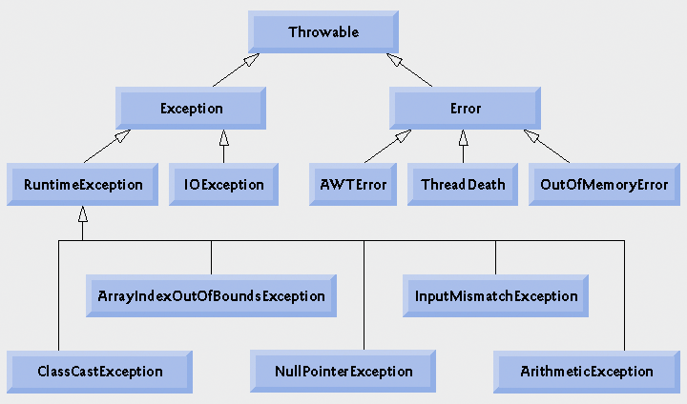
Inheritance hierarchy for class Throwable

Slide 10
Java Exception Classes
ArithmaticException
NullPointerException
ArrayIndexOutOfBoundsException
InsexOut OfBoundsException
ClassCastException
IOException
FileNotFoundException
ClassNotFoundException
SQLException
InterruptedException
EOFException

Slide 11
Exceptions
What are they?
An exception is a representation of an error condition or a situation that is not the expected result of a method.
Exceptions are built into the Java language and are available to all program code.
Exceptions isolate the code that deals with the error condition from regular program logic.

Slide 12
Exceptions
How are they used?
Exceptions fall into two categories:
Checked Exceptions
Unchecked Exceptions
Checked exceptions are inherited from the core Java class Exception. They represent exceptions that are frequently considered “non fatal” to program execution
Checked exceptions must be handled in your code, or passed to parent classes for handling.

Slide 13
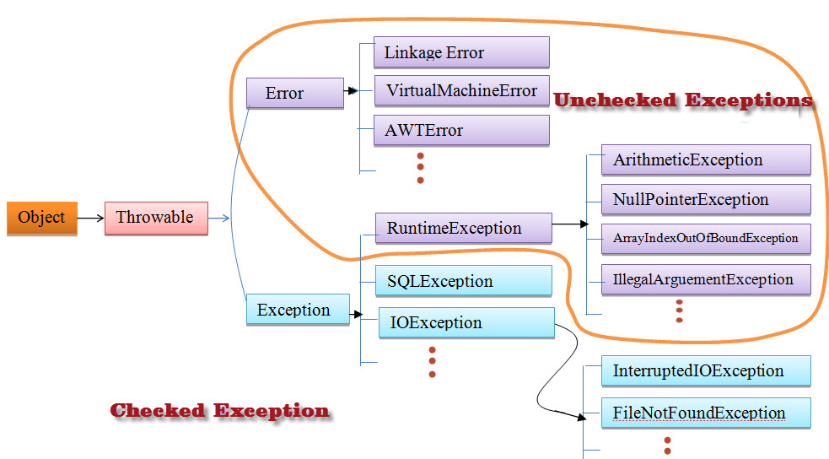

Slide 14
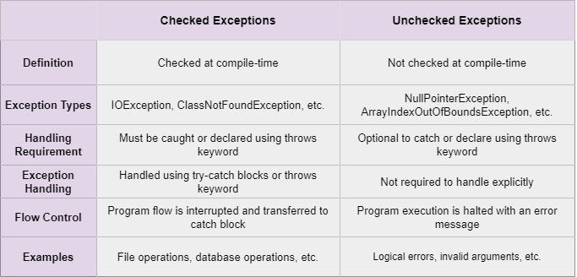

Slide 15
Exceptions
How are they used?
Unchecked exceptions represent error conditions that are considered “fatal” to program execution.
You do not have to do anything with an unchecked exception. Your program will terminate with an appropriate error message.

Slide 16
Exceptions
Examples:
Checked exceptions include errors such as “array index out of bounds”, “file not found” and “number format conversion”.
Unchecked exceptions include errors such as “null pointer”.

Slide 17
Java has 5 keywords for exception handling
Exception
Handling
try
catch
finally
throw
throws
Notes:
What are the dependencies that affect the timeline, cost, and output of this project?

Slide 18
Throwing and catching
An error can throw an exception
throw <exception object>;
By default, exceptions result in the thread terminating after printing an error message
However, exception handlers can catch specified exceptions and recover from error
catch (<exception type> e) {
//statements that handle the exception
}

Slide 19
Throwing an exception
Example creates a subclass of Exception and throws an exception:
class MyException extends Exception { }
class MyClass {
void oops()
{ if (/* no error occurred */)
{ /* normal processing */ }
else { /* error occurred */
throw new MyException();
}
} //oops
}//class MyClass

Slide 20
Catching an exception
try { // statement that could throw an exception
}
catch (<exception type> e) {
// statements that handle the exception
}
catch (<exception type> e) { //e higher in hierarchy
// statements that handle the exception
}
finally {
// release resources
}
//other statements
At most one catch block executes
finally block always executes once, whether there’s an error or not

Slide 21
public class JavaExceptionExample
{
public static void main(String args[])
{
try{
//code that may raise exception
int data=100/0;
}catch(ArithmeticException e)
{
System.out.println(e);
}
//rest code of the program
System.out.println("rest of the code...");
}
}

Slide 22
Output:
Exception in thread main java.lang.ArithmeticException:/ by zero rest of the code...

Slide 23
Multiple catch
try{
//block of statements
}catch(Exception handler class subclass )
{
} catch(Exception handler super class){
}

Slide 24
public class MultipleCatchBlock1 {
public static void main(String[] args) {
try{
int a[]=new int[5];
a[5]=30/0;
}
catch(ArithmeticException e)
{
System.out.println("Arithmetic Exception occurs");
}
catch(ArrayIndexOutOfBoundsException e)
{
System.out.println("ArrayIndexOutOfBounds Exception occurs");
}

Slide 25
catch(Exception e)
{
System.out.println("Parent Exception occurs");
}
System.out.println("rest of the code");
}
}
Output:
Arithmetic Exception occurs
rest of the code

Slide 26
In this example, try block contains two exceptions. But at a time only one exception occurs and its corresponding catch block is executed.
public class MultipleCatchBlock2 {
public static void main(String[] args) {
try{
int a[]=new int[5];
a[5 ] =30/0;
System.out.println(a[10]);
}
catch(ArithmeticException e)
{
System.out.println("Arithmetic Exception occurs");
}

Slide 27
catch(ArrayIndexOutOfBoundsException e)
{
System.out.println("ArrayIndexOutOfBounds Exception occurs");
}
catch(Exception e)
{
System.out.println("Parent Exception occurs");
}
System.out.println("rest of the code");
}
}

Slide 28
Output:
Arithmetic Exception occurs
rest of the code

Slide 29
In this example, we generate NullPointerException, but didn't provide the corresponding exception type. In such case, the catch block containing the parent exception class Exception will invoked.
public class MultipleCatchBlock4 {
public static void main(String[] args) {
try{
String s=null;
System.out.println(s.length());
}

Slide 30
catch(ArithmeticException e)
{
System.out.println("Arithmetic Exception occurs");
}
catch(ArrayIndexOutOfBoundsException e)
{
System.out.println("ArrayIndexOutOfBounds Exception occurs");
}
catch(Exception e)
{
System.out.println("Parent Exception occurs");
}
System.out.println("rest of the code");
}
}

Slide 31
Output:
Parent Exception occurs
rest of the code

Slide 32
To handle the exception without maintaining the order of exceptions (i.e. from most specific to most general).
class MultipleCatchBlock5{
public static void main(String args[]){
try{
int a[]=new int[5];
a[5]=30/0;
}
catch(Exception e){
System.out.println("common task completed");
}
catch(ArithmeticException e){
System.out.println("task1 is completed");
}
catch(ArrayIndexOutOfBoundsException e){
System.out.println("task 2 completed");
}
System.out.println("rest of the code...");
}
}

Slide 33
Output:
Compile-time error

Slide 34
Important Points:
1. If all the exceptions belong to the same class hierarchy, we should be catching the base exception type. However, to catch each exception, it needs to be done separately in their catch blocks.
2. Single catch block can handle more than one type of exception. However, the base (or ancestor) class and subclass (or descendant) exceptions can not be caught in one statement.
For Example
// Not Valid as Exception is an ancestor of // NumberFormatException catch(NumberFormatException | Exception ex)

Slide 35
3. If a catch block handles multiple exceptions, the catch parameter is implicitly final. This means we cannot assign any values to catch parameters.
4. All the exceptions must be separated by vertical bar pipe |.
Syntax:
try {
// code
} catch (ExceptionType1 | Exceptiontype2 ex)
{
// catch block
}

Slide 36
Catching multiple exceptions in a single catch block reduces code duplication and increases efficiency. The bytecode generated while compiling this program will be smaller than the program having multiple catch blocks as there is no code redundancy.

Slide 37
Execution of try catch blocks
For normal execution:
try block executes, then finally block executes, then other statements execute
When an error is caught and the catch block throws an exception or returns:
try block is interrupted
catch block executes (until throw or return statement)
finally block executes
When error is caught and catch block doesn’t throw an exception or return:
try block is interrupted
catch block executes
finally block executes
other statements execute
When an error occurs that is not caught:
try block is interrupted
finally block executes

Slide 38
Handling Exceptions
try {
<code segment that may
throw an exception..>
} catch (ExceptionType) {
<exception handler..>
} catch (ExceptionType) {
<exception handler..>
} finally {
<optional code segment..>
}

Slide 39
Multiple catch statements
Once a try statement has been used to enclose a code segment, the catch can be used to handle one or more specific exception types.
By defining catch statements for specific exception types, a more accurate handling of the exception can be tailored to the programs needs

Slide 40
Exceptions -Syntax
try
{
// Code which might throw an exception
// ...
}
catch(FileNotFoundException x)
{
// code to handle a FileNotFound exception
}
catch(IOException x)
{
// code to handle any other I/O exceptions
}
catch(Exception x)
{
// Code to catch any other type of exception
}
finally
{
// This code is ALWAYS executed whether an exception was thrown
// or not. A good place to put clean-up code. ie. close
// any open files, etc...
}

Slide 41
Multiple catch statements
try {
<code segment that may
throw an exception..>
} catch (IOException e) {
System.out.println(e.getMessage());
} catch (FileNotFoundException e) {
System.out.println(“File Not Found!”);
}

Slide 42
The finally statement
The purpose of the optional finally statement will allow the execution of a segment of code regardless if the try statement throws an exception or executes successfully
The advantage of the finally statement is the ability to clean up and release resources that are utilized in the try segment of code that might not be released in cases where an exception has occurred

Slide 43
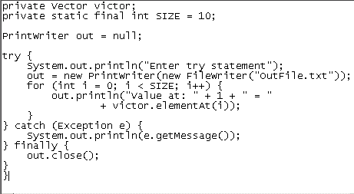
The finally statement

Slide 44
Define your own exception
Here is a code sample showing how to define your own exception.
Define a classs:
public class EmptyStackException extends Exception { }
Here is how you use the class:
public class Stack {
public Object Pop() throws EmptyStackException {
if (Empty()) throw new EmptyStackException(); ...
}
}
Note that you must use new to create an exception object; you cannot just throw an exception.

Slide 45
Thank You
Notes:
Prepare slides for the appendix in the event that more details or supplemental slides are needed. The appendix is also useful if the presentation is distributed later.

